Slide 1
CLASS-IX SUBJECT-MATHEMATICS TOPIC-LINES AND ANGLES

Slide 2
CONTENTS…
LEARNING OBJECTIVES
INTRODUCTION
LINES AND ANGLES IN DAILY LIFE
BASIC TERMS AND DEFINITIONS: LINES
PROPERTIES OF LINES
BASIC TERMS AND DEFINITIONS: ANGLES
SOME AXIOMS AND THEOREMS ON LINES AND ANGELS
SUGGESTED ACTIVITIES
CONCEPT MAPPING
KEY POINTS TO REMEMBER

Slide 3
Learning Objectives..
Students will learn various types of lines and angles and be able to recognize them in the natural world.
Recognise and define lines, line segments and rays and identify obtuse, acute and right angles.
Understand parallel and perpendicular lines.
Understand various key concepts such as Linear Pair, Vertically opposite angles, Adjacent angles, Corresponding angles, Co-interior angles, Alternate angles and so on.

Slide 4
INTRODUCTION
Geometry is composed of two ancient Greek words: Geo and Metron. Geo means Earth and Metron means measurement. Geometry is a branch of mathematics which deals with shape, size, position and spatial relationships and properties of different figures. There are different parameters involved to define a shape. In this chapter, we are going to discuss two important parameters called the lines and angles.

Slide 5
LINES AND ANGLES IN DAILY LIFE
Lines and angles are involves in nearly every aspect of our daily lives. It’s is important for students to be confident on calculating angles, measuring angles and drawing angles and they also need to have a solid knowledge on lines and angles.
We meet many real life situations based on lines and angles. For example, in construction industry, angles make the difference of whether a building is safe or not. Photographers, engineers, dancers and many more professions use this topic widely.

Slide 6
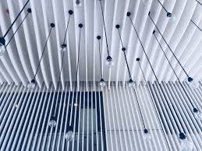

Slide 8
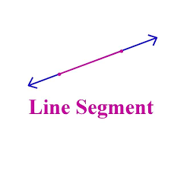
DEFINITION OF LINES AND ANGLES The entire geometry begins with a point. A point is a dimensionless entity which specifies the location or position. It is represented using a dot symbol and its length is zero. What are lines? All the shapes that we see around us consist of an infinite number of points. When a point moves in such a manner that its direction remains unaltered then a straight line is obtained. In other words, a one-dimensional collection of points extending infinitely in both the directions represents a line. A line never ends.

Slide 9
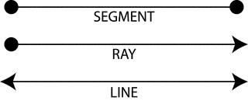
BASIC TERMS & DEFINITIONS:LINES
LINE: A straight path extending in both directions with no end points.
LINE SEGMENT: A part of a line that includes two points, called end points, and all the points between them
RAY: A part of a line, with one end point, that continues without end in one directions

Slide 10
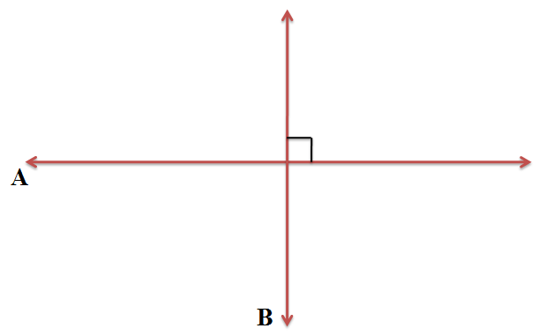
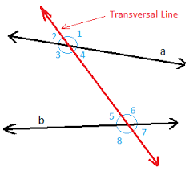
PARALLEL LINES: Two lines are said to be parallel when they do not meet at any point in a plane or which do not intersect each other.
PERPENDICULAR LINES: When two lines form a right angle with each other, by meeting at a single point, are called intersecting lines.
TRANSVERSAL LINES: When a line intersects two lines at distinct points, it is called a transversal
PARALLEL
PERPENDICULAR
TRANSVERSAL

Slide 11
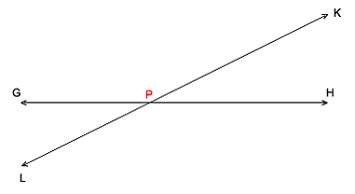
INTERSECTING LINES Two or more lines which share exactly one common point are called intersecting lines. The intersecting lines meet at only one point, no matter at what angle they meet. No two straight lines can meet at more than one point. The lines that meet at more than one point are not straight lines. At least one of them is curve. | NON-INTERSECTING LINES Two or more lines that do not intersect each other are called non-intersecting lines Non-intersecting lines can never meet. They are also known as the parallel lines. They are always at the same distance from one another.
A line on a plane can either be intersecting or non-intersecting.

Slide 12
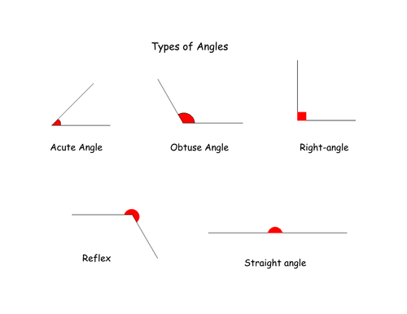
An angle is a figure in which two rays emerge from a common point. This point is called the vertex of the angle and the two rays forming the angle are called its arms or sides…

Slide 13
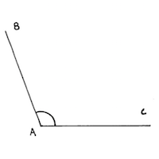
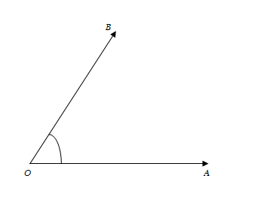
BASIC TERMS AND DEFINITIONS:ANGLES
ACUTE ANGLE: If the inclination between the arms is less than a right angle, it is called an acute angle.
OBTUSE ANGLE: If the inclination between the arms is more than a right angle, it is called an obtuse angle
ACUTE ANGLE
OBTUSE ANGLE

Slide 14
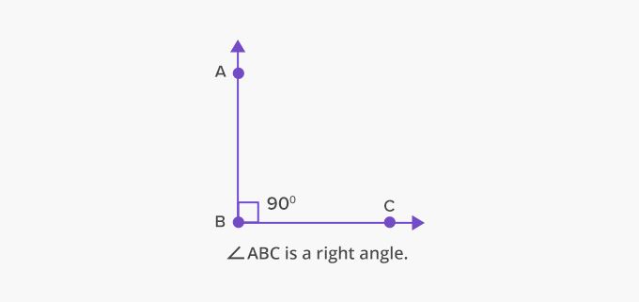
RIGHT ANGLE: If the arms form an angle of 90 degrees between them, it is called a right angle.
STRAIGHT ANGLE: If the arms form an angle of 180 degrees between them, it is called a straight angle.
RIGHT ANGLE
STRAIGHT ANGLE

Slide 15
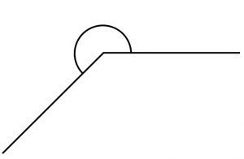
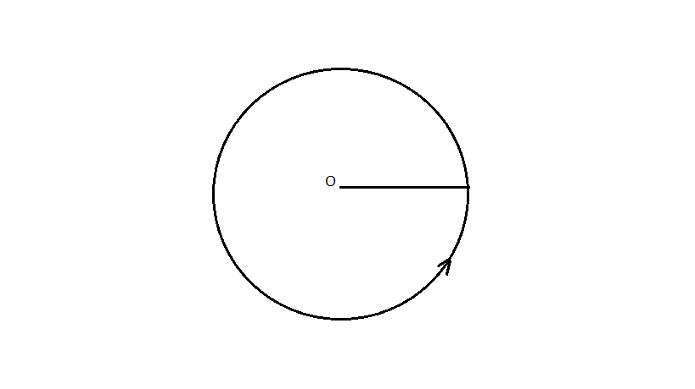
REFLEX ANGLE : An angle which is greater than 180° but less than 360° is called a reflex angle.
COMPLETE ANGLE: A straight line makes an angle of 360° to reach its initial position completely by the rotation. This angle is called a complete angle.
REFLEX ANGLE
COMPLETE ANGLE

Slide 16
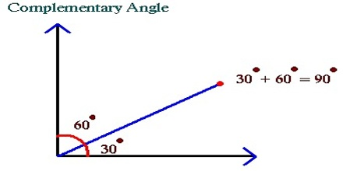
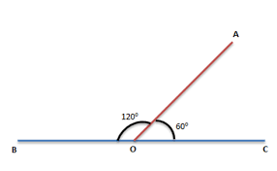
COMPLIMENTARY ANGLES: Two angles which sum up to 90 degrees are called complimentary angles.
SUPPLEMENTARY ANGLES: Two angles which sum up to 180 degrees are called supplementary angles.
Complimentary Angles
Supplementary Angles

Slide 17
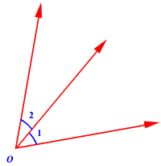
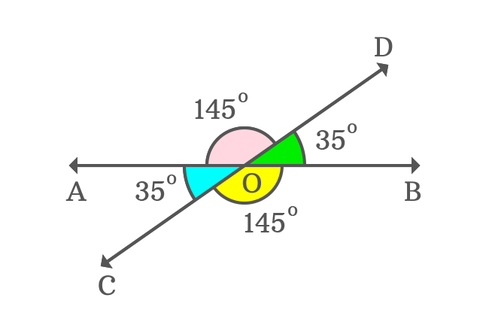
ADJACENT ANGLES: Two angles which have a common side and a common vertex are called adjacent angles.
VERTICALLY OPPOSITE ANGLES: Two angles which are formed opposite to each other, when two lines intersect at a common point or vertex, are called vertically opposite angles.
Adjacent Angles
Vertically opposite Angles

Slide 18
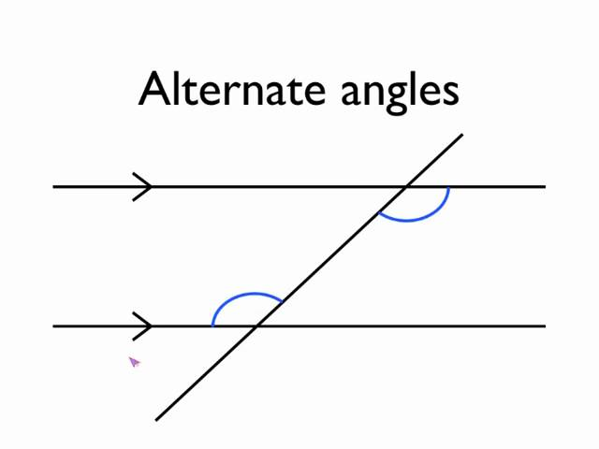
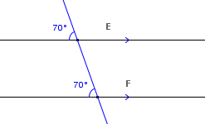
CORRESPONDING ANGLES: The angles which occupy the same relative position at each intersection where a straight line crosses two others. If the two lines are parallel, the corresponding angles are equal.
ALTERNATE INTERIOR ANGLES: Alternate interior angles are formed when a transversal passes through two lines. The angles that are formed on opposite sides of the transversal and inside the two lines are alternate interior angles.
Corresponding Angles
Alternate Interior Angles

Slide 19
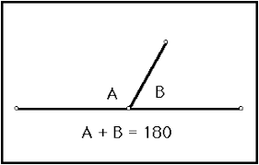
LINEAR PAIR: A linear pair of angle is formed when two lines intersect. Two angles are said to be linear if they are adjacent angles formed by two intersecting lines. The measure of a straight angle is 180°, so a linear pair of angles must add up to 180°.
Linear Pair

Slide 20
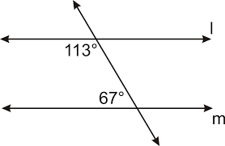
Co-Interior Angles: Co-interior Angles lie between two lines and on the same side of the transversal.
If the two lines are parallel, then co interior angles add to give 180° and so are supplementary.
Co-Interior Angles

Slide 21
QUESTIONS BASED ON PREVIOUS KNOWLEDGE
Two complementary angles are in the ratio 11:7. Find the angles
Three lines in a plane will intersect each other maximum at how many points?
∠ABC+ ∠PQR=180°. Can we say that ∠ABC & ∠PQR are linear pair?
What is the supplementary angle of 20° 20’
What are concurrent lines?
A line has how many end points?
How many right angles are there in a complete angle?

Slide 22
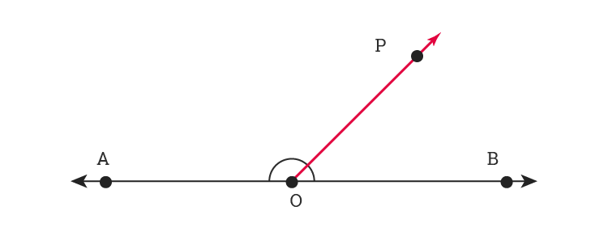
Some axioms & Theorems on Lines And Angles
Axiom 1: If a ray stands on a line, then the sum of two adjacent angles so formed is 180°.
Here we can see the ray OP stands on the line AB and ∠AOP + ∠BOP = 180°. So, it’s a Linear Pair.
Conversely, it can be stated that if the sum of two adjacent angles are 180°, then the non-common arms of the angles form a line.

Slide 23
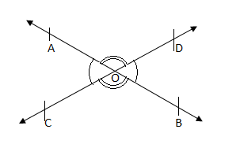
Theorem 1: If two lines intersect each other then the vertically opposite angles are equal.
This theorem can be proved using the Linear-Pair axiom.
Here we need to prove ∠AOC = ∠BOD and ∠AOD = ∠BOC.

Slide 24
Ray OA stands on line CD. Therefore, ∠AOC+∠AOD=180°___(i)
(Linear Pair)
Similarly, ∠AOD+∠BOD=180°____(ii)
(Linear Pair)
From (i) and (ii), we have
∠AOC+∠AOD=∠AOD+∠BOD
⇒∠AOC=∠BOD
Hence Proved.
Similarly, ∠AOD=∠BOC can be prove in the same way.

Slide 25
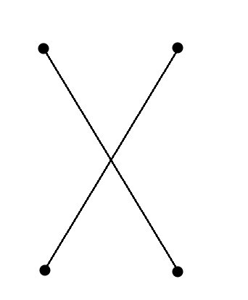
Example based on Theorem 1: In the given figure line AB and CD intersect at O. ∠BOC=36°. Find ∠AOD, ∠AOC & ∠BOD.
Solution: Since line AB and CD intersect at O. Therefore, ∠COB= ∠X ⇒ 36°= ∠X
∠Y= ∠Z (Vertically opposite angles)…(i)
∠COB+ ∠Y=180° (Linear pair) ⇒ 36°+ ∠Y= 180°
∠Y= 180°- 36°= 144°
From (i), ∠Y= ∠Z ⇒ 144°= ∠Z
∠X= 36°, ∠Y= ∠Z=144°
Question: In figure, if ∠AOC+ ∠BOC+ ∠BOD=338 °. Find all the four angles.
C
B
O
A
D
FIGURE

Slide 26
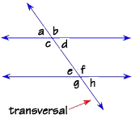
Axiom 2: If a transversal intersects two parallel lines, then each pair of corresponding angles is equal.
Here ∠a = ∠e, ∠c= ∠g, ∠b = ∠f, ∠d = ∠h.
Conversely it can be stated that if a transversal intersects two lines two lines such that a pair of corresponding angles is equal, then the two lines are parallel to each other.

Slide 27
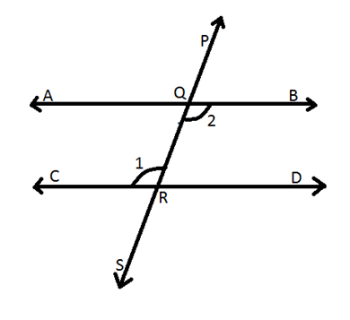
Theorem 2: If a transversal intersects two parallel lines, then each pair of alternate interior angles is equal.
This theorem can be proved using the Corresponding Angles axiom.
To prove: ∠AQR = ∠QRD and CRQ = ∠BQR
∠PQB = ∠QRD…(i) Corresponding Angles.
∠PQB = ∠AQR…(ii) Vertically Opposite Angles.
So from (i) and (ii) we can say that
∠AQR = ∠QRD.
Hence Proved.

Slide 28
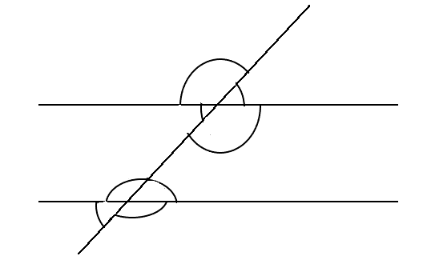
Example based on Theorem 2: In the figure, $l ‖ m$and transversal ‘t’ intersects at A and B. ∠1: ∠2=3:2. Determine all the eight angles.
Solution: ∠1: ∠2=3:2 (given)
Let ∠1=3x° and ∠2=2x°. But ∠1 & ∠2 form a linear pair. Therefore, ∠1+ ∠2=180°
⇒ 3x°+ 2x°= 180° ⇒ 5x°= 180°. So, $x=\frac{180°}{5}=36°$. Therefore, ∠1=3x°=3$×$36°=108° ∠2=2x°=2$×$36°=72°. ∠3=∠2 & ∠4=∠1 (vertically opposite angles) ⇒ ∠3 =72 ° & ∠4=108°
∠5=∠1 & ∠8=∠2 (corresponding angles) ∠5 =108° & ∠8=72°.
∠6=∠8 & ∠7=∠5 (vertically opposite angles)
∠7 =108° & ∠6=72°.
1
l
2
3
4
5
8
m
6
7
FIGURE

Slide 29
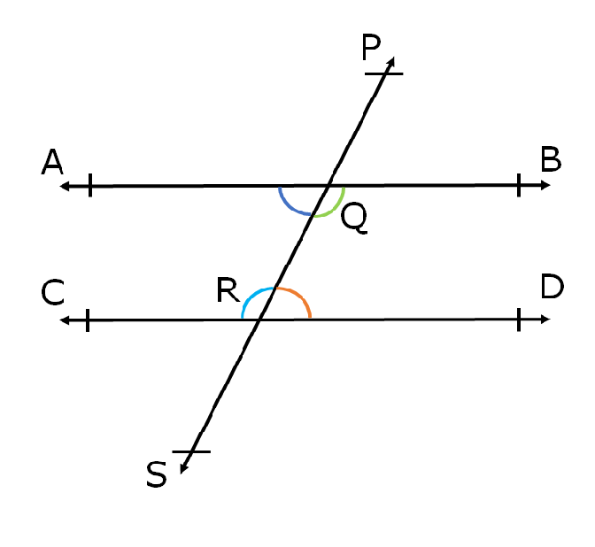
Theorem 3: If a transversal intersects two parallel lines, then each pair of interior angles on the same side of the transversal is supplementary.
To Prove: ∠BQR + ∠DRQ = 180°
and ∠AQR + ∠CRQ = 180°.
∠BQR = ∠CRQ … (i)Alternate Interior Angles
∠CRQ + ∠DRQ = 180° …(ii) Linear Pair
∠BQR+ ∠DRQ = 180°…From (i)
So, ∠BQR+ ∠DRQ = 180°
Similarly ∠AQR + ∠CRQ = 180°
Hence Proved.

Slide 30
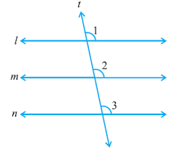
Theorem 4: Lines which are parallel to the same line are parallel to each other.
To prove: Line m ‖ Line n
Given: l || m and l || n;
∠1 = ∠2 …(i) (corresponding angles)
∠1 = ∠3 …(ii) (corresponding angles)
So, ∠2 = ∠3 (From (i) & (ii))
But ∠2 & ∠3 are corresponding angles and they are equal.
Therefore, Line m ‖ Line n.
Hence Proved.

Slide 31
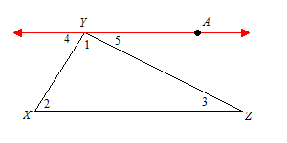
Theorem 5: The sum of the angles of a triangle is 180°.
To prove: ∠1+ ∠2+ ∠3=180°
Given: AY || XZ and XY,ZY are the transversals.
AY is a line. Therefore,
∠4+ ∠1+ ∠5=180°…(i)
But AY ‖ XZ and YX, YZ are transversals.
So, ∠4 = ∠2 & ∠5 = ∠3..(ii) Alternate interior Angles
Substituting ∠4 & ∠5, we get:
∠2+ ∠1+ ∠3=180°
So, ∠1+ ∠2+ ∠3=180°
Hence Proved.

Slide 32
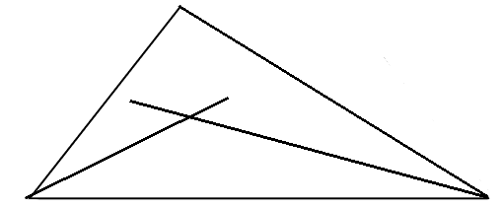
If the internal angle bisectors of the ∠ABCand ∠BCA of the ΔABC intersect each other at point O Prove that: ∠BOC = 90°+$\frac{1}{2}$∠A
Solution: In ΔABC, ∠A + ∠B + ∠C= 180°.
∠B + ∠C= 180°$−$A.=>$\frac{1}{2}$ (∠B+∠C)=90°$−\frac{1}{2}$∠A. In ΔOBC, we have ∠OBC+∠OCB+∠BOC= 180° or ∠BOC= 180°- (∠OBC + ∠OCB)=180° $−$ (90°$−\frac{1}{2}$∠A)=>180°$−$90°+$\frac{1}{2}$∠A or
∠BOC= 90°+$\frac{1}{2}$∠A
A
D
B
C

Slide 33
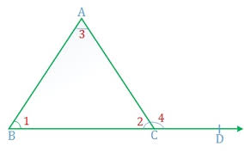
Theorem 6: If a side of a triangle is produced, then the exterior angle so formed is equal to the sum of the two interior opposite angles
To Prove: ∠ACD= ∠ABC + ∠ACB.
∠ABC + ∠BAC + ∠ACB = 180°…(i) Angle Sum Property
∠ACB+ ∠ACD = 180°…(ii) Linear Pair
Subtracting (ii) from (i)…
∠ABC + ∠BAC - ∠ACD = 0°
So, ∠ABC + ∠BAC = ∠ACD .
Hence Proved

Slide 34
SUGGESTED ACTIVITES
1. Draw any angle on the card board. Now draw another angles such that the arms of the second angle are such that the arms of the second angle are parallel to the arms of the first angle. Observe and state, what relation you get between the two angles ?
2. Draw two parallel lines as shown, take any point O below lines AB and CD but between B and C. Measure ∠ABO ,∠ DCO and then find ∠BOC.

Slide 35
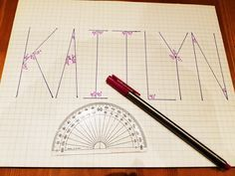
Some interesting activities..
Find which alphabet(Capital) of English Language has the most number of angles..
Try writing your name using lines and angles only..

Slide 36
Activities..

Slide 37
CONCEPT MAPPING

Slide 38
Key points to remember
Two intersecting lines cannot both be equal and parallel to the same line.
If a ray stands on a line, then the sum of two adjacent angles so formed each is 180°.
If the sum of two adjacent angles is 180° then the non-common arms of two angles are two opposite rays.
If two lines intersect, the vertically opposite angles are equal.
Lines which are parallel to the same line are parallel to each other.

Slide 39
Key points to remember
The bisectors of two adjacent supplementary angles form a right angle.
If two parallel lines are cut by a transversal, the pairs of alternate angles are equal.
If two parallel lines are cut by a transversal, the pairs of corresponding angles are equal.
If the sides of a triangle is produced, the exterior angles so formed is equal to the sum of the two interior opposite angles.
If two parallel lines are intersected by a transversal then the bisectors of the interior angles on the same sides of the transversal intersect each other at a right angles.

Slide 40
THANK YOU……

